Slide 1


NewsVerse
NEWSVERSE

Slide 2





NewsVerse
ROLES
Damanjit Singh
Abby Gualda
Stephen Yang
Dewei Wang
Yuhang Wang
NewsVerse Team

Slide 3

NewsVerse
NewsVerse Project Scope
In an effort to provide balanced news coverage we have produced a web application with real-time updates offering a comprehensive range of news categories. This includes business, sports, technology, health and entertainment.
NewsVerse curates content from multiple news sources, ensuring diverse perspectives on current events. We provide unbiased perspectives of articles by creating a bias score.
0-3 (left-leaning), 4-6 (neutral), and 7-10 (right-leaning)

Slide 4

Goals
1
Provide Unbiased News Coverage
Enhance Media Literacy
2
3
Foster Informed Engagement
4
Create a Diverse News Ecosystem
5
Simplify News Access and Experience

Slide 5




Target Users
Busy Professionals
Content creators and Bloggers
News Consumers
Enthusiasts and Analysts

Slide 6
Important Features
News Aggregation
Real-time Updates
Search Funcitonaility
Multi-source comparison
Third-Party Integrations
Personalized News Feed

Slide 7







Essential High Level Project Requirements
3 Second Wait Time Response
2
News content complies with legal requirements &
Architecture supports user volume scale
Ensuring secure data integration of multiple sources
Regular Backups of data to ensure quick recovery in case of data loss
Real - Time Updates with Efficiency

Slide 8
Project Requirements
1
Bias Score
6
Search functionality
Provide Top News Stories in a banner like fashion
Top Keyword List
2
7
8
Widgets
3
Non-Bias Summary of Articles
9
Real - Time Updates
4
Variety of News Sources
5
Multiple News Categories,

Slide 9
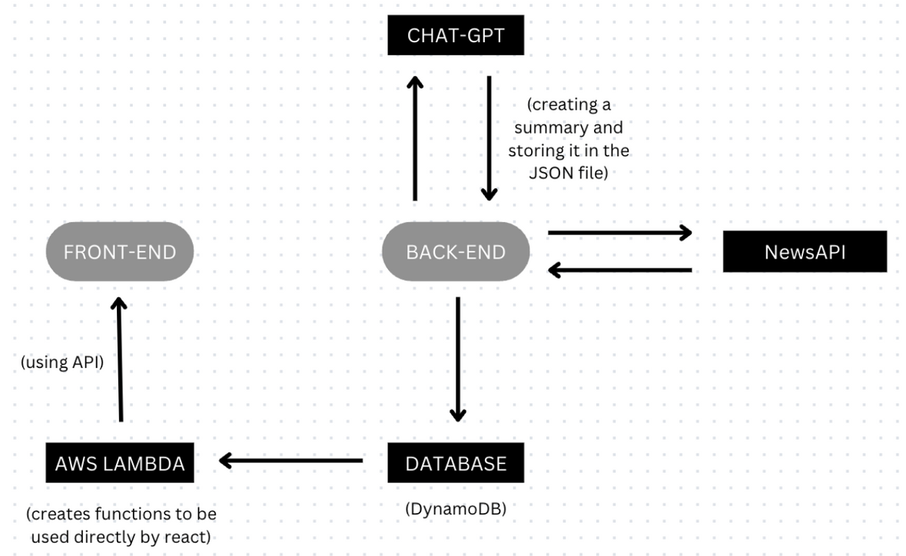
GUI and API Design
High Level Interface API Design:
Vue: Front - end
REST API: communication between front and back end
Data Design:
1
6
Testing:
PyTest and VueTest: Unit and integration testing to ensure the quality of the endpoint and its operation
7
8
Performance:
Timeout limit on per API request
Apply cache to prevent over requesting

Slide 10
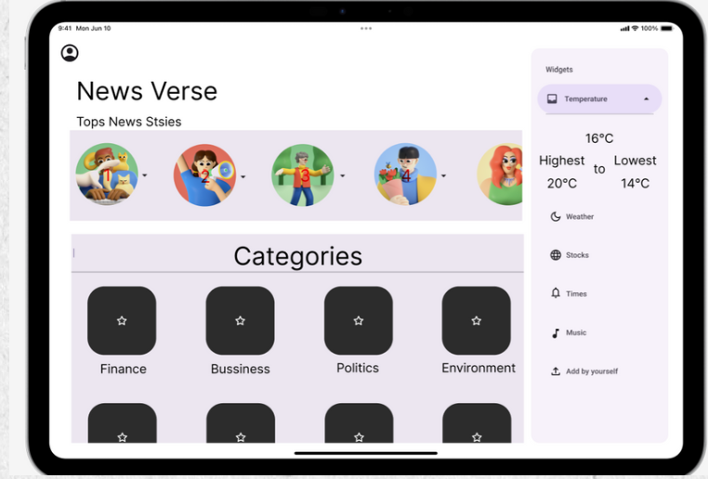
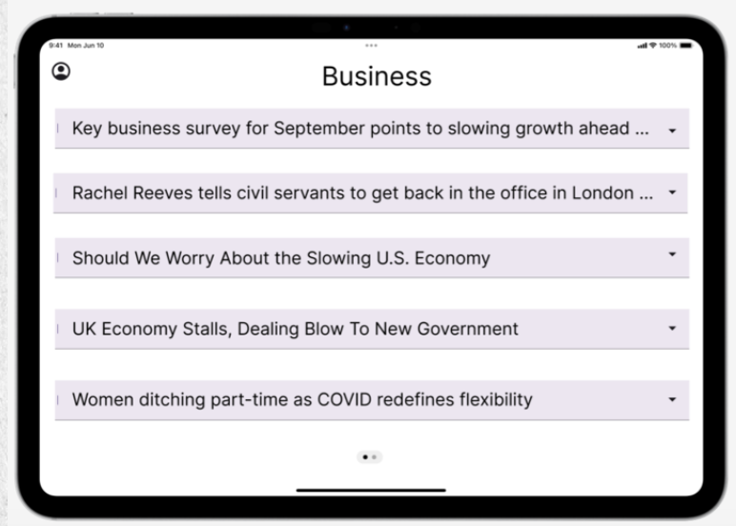
Snapshot of Progress!
NewsVerse
BEFORE

Slide 11
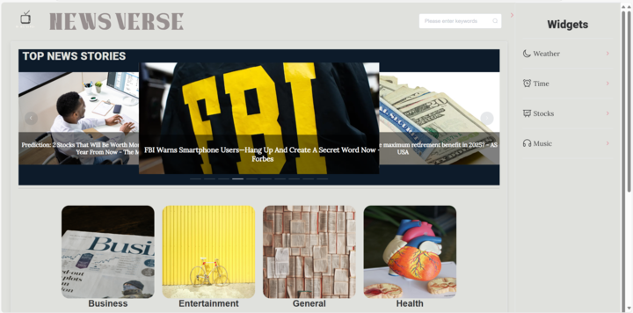
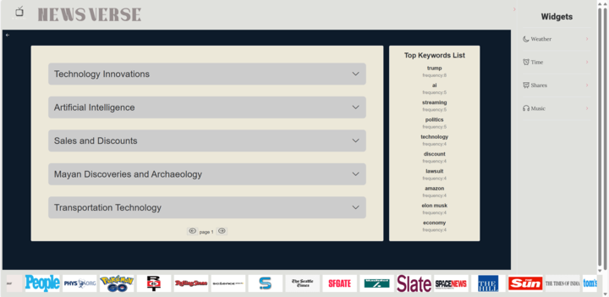
Snapshot of Progress!
NewsVerse
AFTER

Slide 12
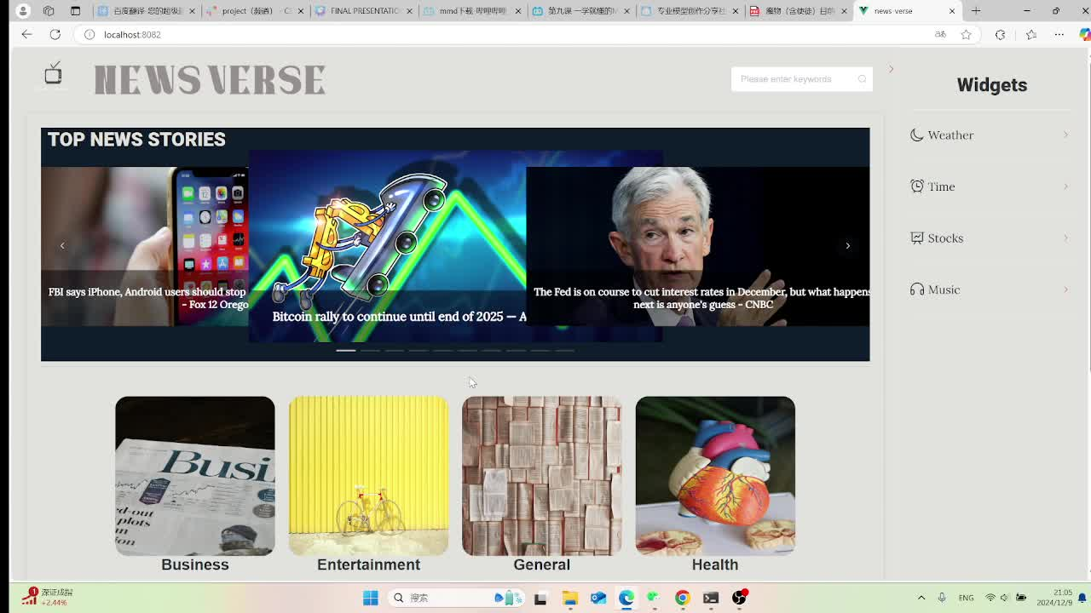
DEMO
NewsVerse

Slide 13
NewsVerse
Update of Final Status
The application has been deployed and is running successfully on the AWS platform.
The batch job is set up and running daily.
The quality of summarization by ChatGPT and the self-build model is guaranteed and works well.
Bias scores have been accurately produced and explained.
The data is captured and processed accurately from the AWS API to the frontend allowing users to gather information.
1
2
3
4
5

Slide 14
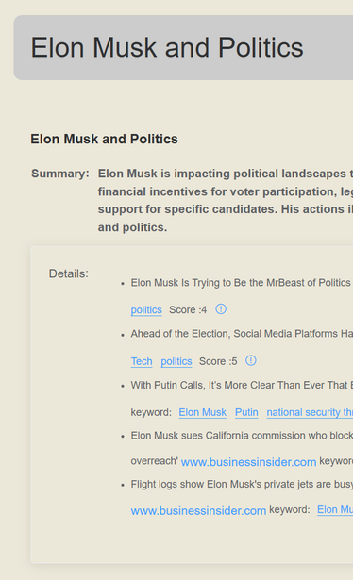
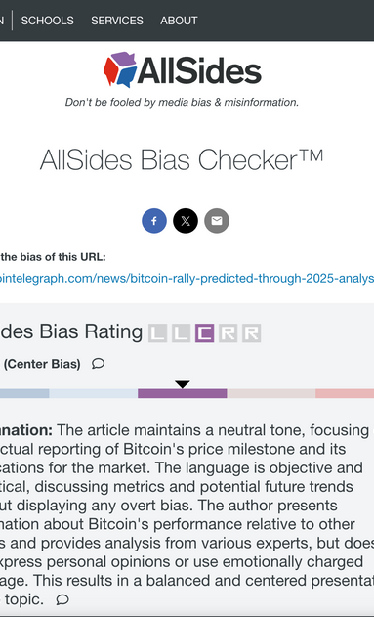

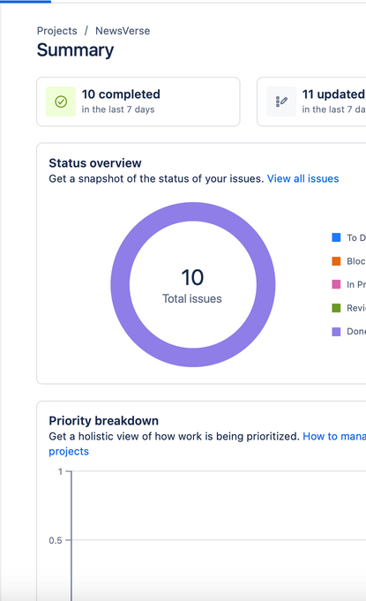

Evaluation and Success on Project
Creation of Summary
Bias Score Evaluation
Frontend Validation Testing
Project Management Values
Backend Validation Testing

Slide 15

Limitations
Response time is a little slow by 1 -2 seconds do to AWS cloud because of its process of reading data.
Testing for frontend has NOT passed because of the version differentations.
Token limitation on ChatGPT so when the tokens are all used up we must switch over to a different version of the ChatGPT models.
There is a cut off of the first few sentences provided to for the description and content.

Slide 16
NewsVerse
Lessons Learned
 | Vue structure for frontend
Technical Backend
Technical Frontend
Project Management
Version Control
Gen AI Models
Fine-tuning model for better adaptation to tasks.
Data Sources Aggregation
Sprint planning is extremely important to project progression
Branching & Collaboration
Data capture from database through API
Team work and Collaboration
Version Restoration
Multiple versions of ChatGPT in place for batch job
Data Pipelines & Processing
Public API use and assets for widgets data
Stick too the timeline and milestones
Merge Conflicts Resolution
Accelerating model inference speed
AWS Architecture

Slide 17



NewsVerse
Future Steps
Ways to Expand
Ways to Monetize
Personalize Accounts
Allow users to choose a personalize feed with their own customizeble widgets
Make an Mobile app verison
Integrate Ads

Slide 18

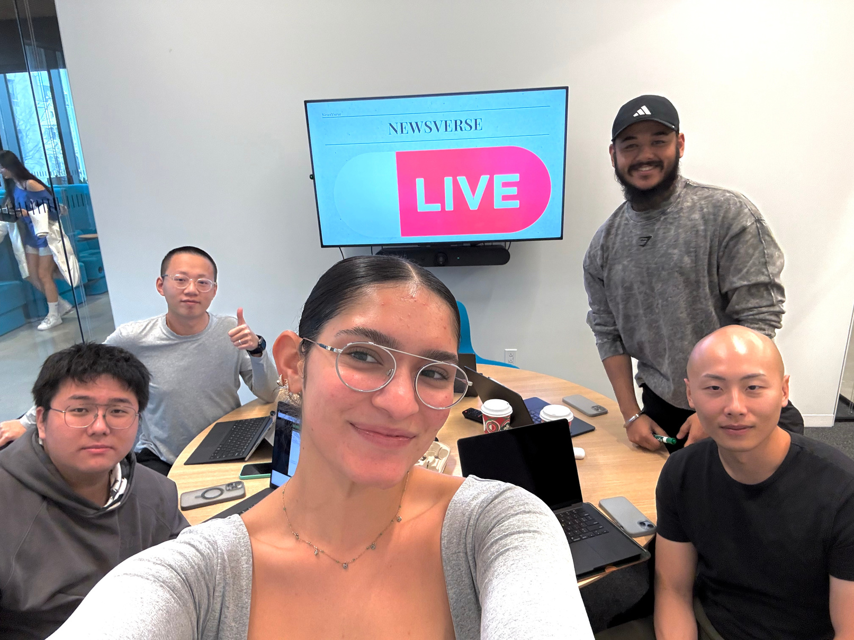
NewsVerse
Thank you!

